Slide 1
Chapter 3
Variables and Calculations

Slide 2
Topics
3.1 Gathering Text Input
3.2 Variables and Data Types
3.3 Performing Calculations
3.4 Mixing Different Data Types
3.5 Formatting Numbers and Dates
3.6 Class-Level Variables
3.7 Exception Handling
3.8 Group Boxes
3.9 The Load Event
3.10 Focus on Program Design and Problem Solving: Building the Room Charge Calculator Application
3.11 More about Debugging: Locating Logic Errors

Slide 3
Gathering Text Input
3.1

Slide 4
Visual Basic
Log into your computer
Go to socrative.com vocab quiz
Turn to page 112
Objective
The student should be able to gather input the user has typed through a GUI application

Slide 5
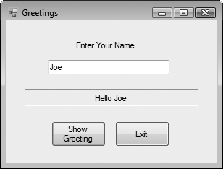
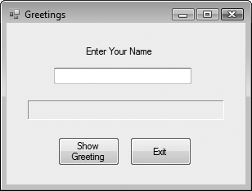
The TextBox Control
A text box is a rectangular area on a form that accepts input from a keyboard
Tutorial 3-1 provides an example in the use of a text box
Objective
The student should be able to gather input the user has typed through a GUI application

Slide 6
Using the Text Property in Code
The TextBox control’s Text property can be accessed in code the same way you access other properties
For Example:
The contents of the Text property can be assigned into a Label control’s Text property:
lblInfo.Text = txtInput.Text
The contents of the Text property can be displayed in a message box
MessageBox.Show(txtInput.Text)
Objective
The student should be able to gather input the user has typed through a GUI application

Slide 7
Clearing a Text Box
Can be done with an assignment statement:
txtInput.Text = String.Empty
Assigning the predefined constant String.Empty replaces whatever text was in txtInput with an empty string
Can also be done with a method:
txtInput.Clear()
Clear is a method, not a property
Methods are actions – as in clearing the text
Uses the form Object.Method
Objective
The student should be able to gather input the user has typed through a GUI application

Slide 8
String Concatentation
Assume the user has entered their name into the TextBox txtName
Label lblGreeting can say, “Hello” to any name found in the TextBox
lblGreeting.Text = "Hello " & txtName.Text
Appends user name in txtName.Text to "Hello " and stores result in text property of lblGreeting
Objective
The student should be able to gather input the user has typed through a GUI application

Slide 9
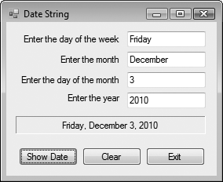
String Concatenation
Tutorial 3-2 provides another example of how to concatenate strings from text boxes
txtDayOfWeek
txtMonth
txtDayOftheMonth
txtYear
lblDateString
btnExit
btnClear
btnShowDate
Objective
The student should be able to gather input the user has typed through a GUI application

Slide 10
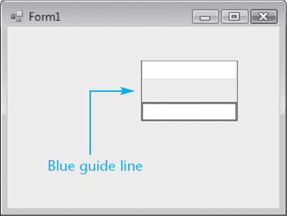
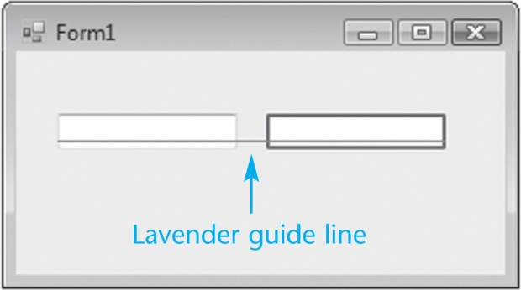
Aligning Controls in Design Mode
When dragging a control to a form, it can be aligned with a control already on the form
Blue guide lines appear for vertical alignment
Lavender guide lines for horizontal alignment
Objective
The student should be able to gather input the user has typed through a GUI application

Slide 11
The Focus Method
For a control to have the focus means that it is ready to receive the user's input
In a running form, one and only one of the controls on the form may have the focus
Only a control capable of receiving some sort of input may have the focus
The focus can be set to a control in code using the Focus method:
txtUserName.Focus()
Objective
The student should be able to gather input the user has typed through a GUI application

Slide 12
The Focus Method
You can tell which control has focus by its characteristics:
When a TextBox has focus, it will have a blinking cursor or its text will be highlighted
When a button, radio button, or a check box has focus, you’ll see a thin dotted line around the control
Tutorial 3-3 shows an example of the Focus method

Slide 13
Controlling a Form’s Tab Order with the TabIndex Property
Tab key steps focus from one control to the next
This order is set by the TabIndex property
The Tab key causes the focus to jump to the control with the next highest TabIndex value
The TabIndex property is best changed with the Tab Order option from the VIEW menu
Displays the form in tab order selection mode
Set a new tab order by clicking the controls in the order you want
This sets the numeric TabIndex value

Slide 14
Assigning Keyboard Access Keys to Buttons
Say your form had a button with the text “Exit" on it
You can allow the user to activate the button using Alt + X instead of a mouse click
Just change the button text property to “E&xit"
The character following the '&' (x in this case) is designated as an access key
Be careful not to use the same access key for two different buttons

Slide 15
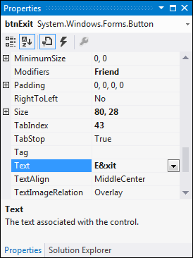
'&' Has Special Meaning in a Button
Note that the '&' in “E&xit" does not display in the button control on the form
It simply establishes the Alt Key access
In order to actually display an '&' on a button, it must be entered as "&&"
Button text Save & Exit is entered as Save && Exit

Slide 16
Setting the Accept Button
The accept button is a button that is implicitly activated if the user hits the Enter Key
The AcceptButton Property designates which button on the form will behave in this manner
The button clicked most frequently on a form is usually assigned as the accept button

Slide 17
Setting the Cancel Button
The cancel button is a button that is implicitly activated if the user hits the Escape Key
The CancelButton Property designates which button on the form will behave in this manner
Any exit or cancel button on a form is a candidate to become the cancel button
Tutorial 3-5 provides examples of setting access keys, accept, and cancel buttons

Slide 18
Variables and Data Types
3.2

Slide 19
Why Have Variables?
A variable is a storage location in the computer’s memory, used for holding information while the program is running
The information that is stored in a variable may change, hence the name “variable”

Slide 20
What Can You Do With Variables?
Copy and store values entered by the user, so they may be manipulated
Perform arithmetic on values
Test values to determine that they meet some criterion
Temporarily hold and manipulate the value of a control property
Remember information for later use in the program

Slide 21
How to Think About Variables
You the programmer make up a name for the variable
Visual Basic associates that name with a location in the computer's RAM
The value currently associated with the variable is stored in that memory location

Slide 22
Declaring Variables
A variable declaration is a statement that creates a variable in memory
The syntax is:
Dim VariableName As DataType
Dim (short for Dimension) is a keyword
VariableName is the programmer designated name
As is a keyword
DataType is one of many possible keywords for the type of value the variable will contain
Here is an example of a variable declaration:
Dim intLength as Integer

Slide 23
Declaring Multiple Variables
Several variables may be declared in one statement if they all hold the same type of value
Dim intLength, intWidth, intHeight as Integer
Or this can be done in 3 separate statements
Dim intLength as Integer
Dim intWidth as Integer
Dim intHeight as Integer

Slide 24
Variable Naming Rules
The first character of a variable name must be a letter or an underscore
Subsequent characters may be a letter, underscore, or digit
Thus variable names cannot contain spaces or periods (or many other kinds of characters)
Visual Basic keywords cannot be used as variable names

Slide 25
Variable Naming Conventions
Naming conventions are a guideline to help improve readability but not required syntax
A variable name should describe its use
Each data type has a recommended prefix, in lower case, that begins the variable name
The 1st letter of each subsequent word in the variable name should be capitalized
intHoursWorked - an integer variable
strLastName - a String variable

Slide 26
Setting the Value of a Variable
An assignment statement is used to set the value of a variable, as in:
Assign the value 112 to the variable intLength
intLength = 112
Assign the string literal “Good Morning “ followed by the contents of the text box txtName to the variable strGreeting
strGreeting = "Good Morning " & txtName.Text
An assignment changes only the left operand
The right operand remains unchanged

Slide 27
Visual Basic Data Types
Integer types
Byte
Short
Integer
Long
Floating-Point types
Single
Double
Decimal
Other data types
Boolean
Char
String
Date

Slide 28
Integer Data Types
For values that will always be a whole number
Usually name a variable starting with a 3 or 4 letter prefix indicating the variable’s type
Data Type | Naming Prefix | Description
Byte | byt | Unsigned integer from 0 to 255
Short | shrt | Signed integer from -32,768 to 32,767
Integer | int | Signed integer from -2,147,483,648 to 2,147,483,647
Long | lng | Signed integer from -9,223,372,036,854,775,808 to 9,223,372,036,854,775,807

Slide 29
Floating-Point Data Types
For values that may have fractional parts
Single used most frequently
Double sometimes used in scientific calculations
Decimal often used in financial calculations
Data Type | Naming Prefix | Description
Single | sng | As large as 10³⁸ plus or minus, 7 decimal positions
Double | dbl | As large as 10³⁰⁸ plus or minus,15 decimal positions
Decimal | dec | As large as 10²⁹ plus or minus, 29 decimal positions

Slide 30
Other Common Data Types
Boolean – variable naming prefix is bln
Holds 2 possible values, True or False
Char – variable naming prefix is chr
Holds a single character
Allows for characters from other languages
String – variable naming prefix is str
Holds a sequence of up to 2 billion characters
Date – variable naming prefix is dat or dtm
Can hold date and/or time information

Slide 31
The String Data Type
A string literal is enclosed in quotation marks
The following code assigns the name Jose Gonzales to the variable strName
Dim strName as String
strName = "Jose Gonzales"
An empty string literal can be coded as:
Two consecutive quotation marks
strName = ""
Or by the special identifier String.Empty
strName = String.Empty

Slide 32
The Date Data Type
Date data type variables can hold the date and time or both
You can assign a date literal to a Date variable, as shown here:
Dim dtmBirth As Date
dtmBirth = #5/1/2010#
A date literal is enclosed within # symbols
All of the following Date literals are valid: #12/10/2010#
#8:45:00 PM#
#10/20/2010 6:30:00 AM#

Slide 33
Assigning Text to a Variable
Tutorial 3-6 provides an example of how the contents of text boxes are assigned to a string variable
' Declare a string variable to hold the full name.
Dim strFullName As String
' Combine the first and last names
' and copy the result to lblFullName
strFullName = txtFirstName.Text & " " & txtLastName.Text
lblFullName.Text = strFullName

Slide 34
Declaring Variables with IntelliSense
As you enter your program, VB often aids you by offering a list of choices that could be used at that point
After typing "As" in a variable declaration, VB will offer an alphabetical list of all possible data types
Type the first few letters of the data type name
IntelliSense box will highlight the matching type
Press the Tab key to select highlighted choice
Or just complete typing the entire data type name

Slide 35
Default Values and Initialization
When a variable is first created in memory, it is assigned a default value
Numeric types are given a value of zero
Boolean types are given a value of False
Strings are given a value of Nothing
Dates default to 12:00:00 AM January 1,1
Good practice to initialize string variables
Dim strName as String = String.Empty
String with value Nothing causes error if used

Slide 36
Initialization of Variables
Can provide a starting or initialization value for any type of variable in a Dim statement
Usually want to set an initial value unless assigning a value prior to using the variable
Just append = value to the Dim statement where value is the literal to be assigned to the variable
Dim intMonthsPerYear As Integer = 12

Slide 37
Scope and Local Variables
Scope refers to the part of the program where:
A variable is visible and
May be accessed by program code
Variables declared within a procedure are called local variables and observe these characteristics
Scope begins where variable is declared
Extends to end of procedure where declared
Variable is not visible outside the procedure
A variable cannot be declared twice in the same procedure

Slide 38
Performing Calculations
3.3

Slide 39
Properties for Buttons page 152
+ is btnPlus
is btnMinus
X is btnMultiply
^ is btnExponent
/ is btnDivide
\ is btnIntegerDivide
Modulus is btnMod
Result Label is lblResult
Number 1 textbox is txtNumber1
Clear is btnClear
Number 2 textbox is txtNumber2

Slide 40
Common Arithmetic Operators
Visual Basic provides operators for the common arithmetic operations:
+ Addition
- Subtraction
* Multiplication
/ Division
^ Exponentiation

Slide 41
Common Arithmetic Operators
Addition
dblTotal = dblPrice + dblTax
Subtraction
dblNetPrice = dblPrice – dblDiscount
Multiplication
intArea = intLength * intWidth
Division
dblAverage = intTotal / intItems
Exponentiation
dblCube = dblSide ^ 3

Slide 42
Special Integer Division Operator
The backslash (\) is used as an integer division operator
Divides one integer by another
The result is always an integer, created by discarding any remainder from the division
If calculating the number of hours in a given number of minutes
intHours = intMinutes \ 60
With intMinutes equal to 190, this calculation will result in the value 3 assigned to intHours

Slide 43
Modulus (MOD) Operator
This operator can be used in place of the backslash operator to give the remainder of a division operation
intRemainder = 17 MOD 3 ' result is 2
dblRemainder = 17.5 MOD 3 ' result is 2.5
Use of the \ or MOD operator to perform integer division by zero causes a DivideByZeroException runtime error

Slide 44
Retrieving the Current Date/Time
A series of keywords yields the current date, current time, or both
Variables datCurrent, datCurrTime, and datCurrDate must be declared as Date data types
Description | Keyword | Example
Date & Time | Now | dtmCurrent=Now
Time only | TimeOfDay | dtmCurrTime=TimeOfDay
Date only | Today | dtmCurrDate=Today

Slide 45
Combined Assignment Operators
Often need to change the value in a variable and assign the result back to that variable
For example: intValue = intValue – 5
Subtracts 5 from the value stored in intValue
Other examples:
x = x + 4 Adds 4 to x
x = x – 3 Subtracts 3 from x
x = x * 10 Multiplies x by 10
VB provides for this common need with combined assignment operators

Slide 46
Combined Assignment Operators
These special assignment operators provide an easy means to perform these common operations:
Operator Usage Equivalent to Effect
+= x += 2 x = x + 2 Add to
-= x -= 5 x = x – 5 Subtract from
*= x *= 10 x = x * 10 Multiply by
/= x /= y x = x / y Divide by
\= x \= y x = x \ y Int Divide by
&= a &= b a = a & b Concatenate

Slide 47
Arithmetic Operator Precedence
Operator precedence tells us the order in which operations are performed
From highest to lowest precedence:
Exponentiation (^)
Multiplicative (* and /)
Integer Division (\)
Modulus (MOD)
Additive (+ and -)
Where precedence is the same, operations occur from left to right

Slide 48
Operator Precedence Examples
The result is very different when the divide by 2 operation is moved to a different location in the expression
6 * 2 ^ 3 + 4 / 2
6 * 8 + 4 / 2
48 + 4 / 2
48 + 2
50
6 / 2 * 2 ^ 3 + 4
6 / 2 * 8 + 4
3 * 8 + 4
24 + 4
28

Slide 49
Grouping with Parentheses
Parentheses () can be used to force selected parts of an expression to be evaluated before others
Assume we’re computing the average of 3 numbers
dblAvg = int1 + int2 + int3 / 3 ' incorrect
int3 / 3 is evaluated first
That result is added to int1 and int2
Use parentheses to control order of operations
dblAvg = (int1 + int2 + int3) / 3 ' correct
int1 + int2 + int3 is evaluated first
That result is divided by 3
When in doubt, use parentheses!

Slide 50
Converting Mathematical Expressions to Programming Statements
In algebra, the mathematical expression 2xy describes the value 2 times x times y.
Visual Basic requires an operator for any mathematical operation.
Mathematical Expression | Operation | VB Equivalent
6B | 6 times B | 6 * B
(3)(12) | 3 times 12 | 3 * 12
4xy | 4 times x times y | 4 * x * y

Slide 51
Mixing Different Data Types
3.4

Slide 52
Implicit Type Conversions
A value of one data type can be assigned to a variable of a different type
An implicit type conversion is an attempt to convert to the receiving variable’s data type
A widening conversion suffers no loss of data
Converting an integer to a double
Dim dblVal As Double = 5
A narrowing conversion may lose data
Converting a decimal to an integer
Dim intNum As Integer = 12.2 ' intNum becomes 12

Slide 53
Option Strict
Option Strict is a VB configuration setting
Only widening conversions are allowed when Option Strict is set to On
An integer can be assigned to a decimal
A decimal cannot be assigned to an integer
A single can be assigned to a double
A double cannot be assigned to a single
Option Strict On is recommended to help catch errors

Slide 54
Type Conversion Runtime Errors
Consider the statement: Dim intCount As Integer = "abc123"
This is a narrowing conversion
With Option Strict On, statement will not compile
With Option Strict Off, statement compiles but
String "abc123" will not convert to an integer
A runtime error called a type mismatch occurs when this statement is executed

Slide 55
Literals
Type | Description | Example
Boolean Keywords | True and False | True
Byte | Decimal digits between 0 and 255 | 200
Char | Character surrounded by double quotes followed by lowercase C | "A"c
Date | Date and/or time representation enclosed in # | #1/1/14#
Decimal | Digits with decimal point followed by D or @ | +32.0D
Double | Digits with decimal point followed by optional R | 3.5R
Integer | Decimal digits followed by optional letter I | -3054I
Long | Decimal digits followed by the letter L | 40000L
Short | Decimal digits followed by the letter S | 12345S
Single | Digits with decimal point followed by letter F or ! | 26.4F
String | Characters surrounded by double quotes | "ABC123"

Slide 56
Named Constants
Programs often need to use given values
For example: dblTotal *= 1.06
Adds 6% sales tax to an order total
Two problems with this approach
The reason for multiplying dblTotal by 1.06 isn’t always obvious
If sales tax rate changes, must find and change every occurrence of .06 or 1.06
Use of named constants resolves both these issues

Slide 57
Named Constants
Can declare a variable whose value is set at declaration and cannot be changed later:
Const dblSALES_TAX_RATE As Double = 1.06
Looks like a normal declaration except:
Const used instead of Dim
An initialization value is required
By convention, entire name capitalized with underscore characters to separate words
The objective of our code is now clearer
Const dblSALES_TAX_RATE As Double = 1.06
dblTotal *= dblSALES_TAX_RATE

Slide 58

Explicit Type Conversions
A function performs some predetermined operation and provides a single output
VB provides a set of functions that permit narrowing conversions with Option Strict On
These functions will accept a constant, variable name, or arithmetic expression
The function returns the converted value

Slide 59
Explicit Type Conversions
The following narrowing conversions require an explicit type conversion
Double to Single
Single to Integer
Long to Integer
Boolean, Date, Object, String, and numeric types represent different sorts of values and require conversion functions as well

Slide 60
Explicit Type Conversion Examples
Rounding can be done with the CInt function
intCount = CInt(12.4) ' intCount value is 12
intCount = CInt(12.5) ' intCount value is 13
CStr converts an integer value to a String
Dim strText As String = CStr(26)
CDec converts a String to a Double
Dim dblPay As Double = CDbl("$1,500")
CDate converts a String to a Date
Dim datHired As Date = CDate("9/14/2014")

Slide 61
Commonly Used Conversion Functions
Here are some commonly used conversion functions:
Function | Description
Cint (expression) | Converts expression to an Integer
Cdbl (expression) | Converts expression to a Double
Cdate (expression) | Converts expression to a Date
Cdec (expression) | Converts expression to a Decimal
Cstr (expression) | Converts expression to a String

Slide 62
A Full List of Conversion Functions
There are conversion functions for each data type:
CBool ( expression ) CInt ( expression )
CByte ( expression ) CLng ( expression )
CChar ( expression ) CObj ( expression )
CDate ( expression ) CShort ( expression )
CDbl ( expression ) CSng ( expression )
CDec ( expression ) CStr ( expression )

Slide 63
Invalid Conversions
Conversion functions can fail
Dim dblSalary As Double = CDbl("xyz")
Dim datHired As Date = CDate("5/35/2014")
String "xyz" can’t be converted to a number
There’s no day 35 in the month of May
Failed conversions cause a runtime error called an invalid cast exception

Slide 64
Formatting Numbers and Dates
3.5

Slide 65
Formatting
Turn to page 154
Formatting Numbers and Dates
Objective
The student should be able to convert and format numbers and dates

Slide 66
The ToString Method
Converts the contents of a variable as a String
Every VB data type has a ToString method
Uses the form VariableName.ToString
Value in VariableName is converted to a String
Objective
The student should be able to convert and format numbers and dates

Slide 67
The ToString Method
For example: Dim number As Integer = 123 lblNumber.Text = number.ToString
Converts integer 123 to string "123"
Then assigns the String to the Text property of the lblNumber control
Objective
The student should be able to convert and format numbers and dates

Slide 68
ToString Method with Format String
Can pass a format string to the ToString method
Indicates how you want to format the string
For example Dim dblSample As Double Dim strResult As String dblSample = 1234.5 strResult = dblSample.ToString("c")
The value "c" is a format string
Converts 1234.5 to currency format $1,234.50

Slide 69
Types of Format Strings page 155
Format String | Description
N or n | Number format includes commas and displays 2 digits to the right of the decimal
F or f | Fixed point format 2 digits to the right of the decimal but no commas
E or e | Exponential format displays values in scientific notation with a single digit to the left of the decimal point. The exponent is marked by the letter e, and the exponent has a leading + or - sign.
C or c | Currency format includes dollar sign, commas, and 2 digits to the right of the decimal
P or p | Percent format multiplies number by 100 and displays with a trailing space and percent sign

Slide 70
Specifying Decimal Precision
Can add an integer to the format string to indicate number of digits to display after the decimal point
Rounding occurs when displaying fewer decimal positions than the number contains as in the 2nd line
Number Value | Format String | ToString() Value
12.3 | n3 | 12.300
12.348 | n2 | 12.35
1234567.1 | n | 1,234,567.10
123456.0 | f2 | 123456.00
123456.0 | e3 | 1.235e+005
.234 | p | 23.40%
–1234567.8 | c | ($1,234,567.80)

Slide 71
Specifying Integer Leading Zeros
Can specify a minimum width when displaying an integer value
Leading zeros are inserted to meet the minimum width if needed
Number Value | Format String | ToString() Value
23 | D | 23
23 | D4 | 0023
1 | D2 | 01

Slide 72
Formatting Dates and Times
The ToString method can format a Date or DateTime value in a variety of ways
If the date is 8/20/2013 and the time is 3:22 PM
Tutorial 3-8 provides an opportunity to work with number formatting concepts
Format String | Description | ToString() Value
d | Short Date | "8/20/2013"
D | Long Date | "Tuesday, August 20, 2013"
t | Short Time | "3:22 PM"
T | Long Time | "3:22:00 PM"
F | Long Date & Time | "Tuesday August 20, 2013 3:22:00 PM"

Slide 73
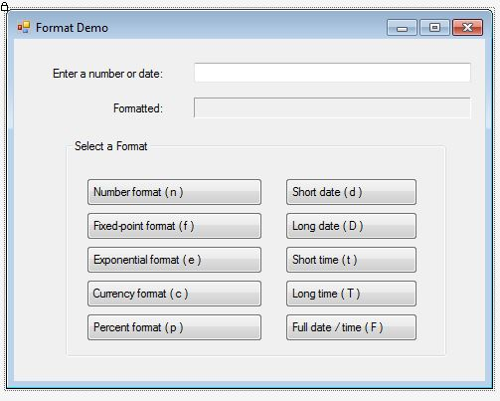

Slide 74
Turn to page 157 tutorial 3-8
Number Format
Dim dblValue As Double = CDbl(txtValue.Text)
lblFormatted.Text = dblValue.ToString("n")
Short Date
Dim dtmValue As Date = CDate(txtValue.Text)
lblFormatted.Text = dtmValue.ToString("d")

Slide 75
Turn to page 161
Complete the tutorial
Place assignments in your notebook
Turn in your notebook for a grade.
Looking for pg 113, 115, 151, 157, 161
And I am looking for notes in class

Slide 76
Class-Level Variables
3.6

Slide 77
Class-Level Variables
A variable declared inside a class but outside any procedure is a class-level variable
Scope is throughout all procedures of the class
Take care when using class-level variables:
Tracking down logic errors can be time consuming because many statements can access the variable
Make sure not to upset the accuracy of variables that are used in multiple procedures
Because all statement can access the variables, you must be aware of every statement that has access

Slide 78
Class-Level Constants
A class-level constant is a named constant declared with the Const keyword, at the class level
Class-level constants cannot be changed during runtime
Eliminates many of the potential hazards that are associated with the use of class-level variables
Generally more acceptable to use than class-level variables

Slide 79
Class-Level Declarations
Public Class Form1
' Begin after class declaration.
' Declare a class-level constant.
Dim Const intVALUE As Integer = 0
' Declare a class-level variable.
Dim intValue As Integer
' End before procedure declarations.
Private Sub Procedure()
End Sub
End Class

Slide 80
Exception Handling
3.7

Slide 81
Runtime Errors
We’ve shown two possible runtime errors
DivideByZeroException
InvalidCastException
There are many others
Runtime errors occur for may reasons
A runtime error results when:
Visual Basic throws an exception
And it is an unhandled exception
Exception handling allows a program to fail gracefully and recover if possible

Slide 82
Handling Exceptions
Visual Basic provides an exception handler
The Try-Catch statement:
Try
' Try block statements…
Catch
' Catch block statements…
End Try
The try block contains program statements that might throw an exception
The catch block contains statements to execute if an exception is thrown

Slide 83
Exception Handling Example
If CDec throws a cast exception, the try block catches it, jumps to and executes the catch block which displays the error message
Try
' Get the user's input and convert it to a Decimal.
decSalary = CDec(txtSalary.Text)
' Display the user's salary.
MessageBox.Show("Your salary is " & decSalary.ToString("c"))
Catch
' Display an error message.
MessageBox.Show("Please try again, and enter a number.")
End Try

Slide 84
Group Boxes
3.8

Slide 85
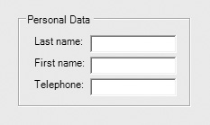
The GroupBox Control
A GroupBox creates a grouping of controls
Controls are enclosed in a box with a title
It’s apparent the controls within the GroupBox are related in some way
Controls in a GroupBox have their own tab order
Moving a GroupBox moves its controls with it
Removing a GroupBox also removes all controls within it

Slide 86
Placing Controls Within a Group Box
Must create the GroupBox first
Then select the GroupBox control and
Double-click the tool from the ToolBox to place the control in the group
or
Click and drag the control from the ToolBox to the GroupBox
To move an existing control to a GroupBox
Select the control and cut it from the form
Select the group and paste the control into it

Slide 87
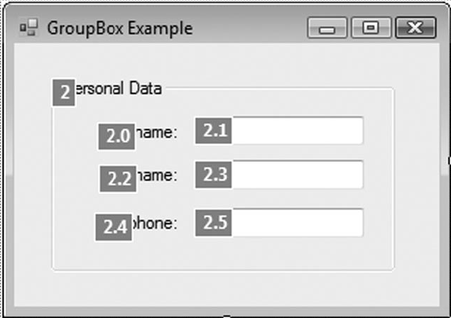
Group Box Tab Order
A GroupBox has it’s own place in form tab order
Once the tab order reaches the GroupBox
Must tab through all controls in the GroupBox before tabbing to controls outside GroupBox
Tab order of controls inside the GroupBox can be assigned in any order
The GroupBox to the right is 2nd in the form tab order
Tab order of controls in the GroupBox is 2.1, 2.3, & 2.5

Slide 88
Selecting and Moving Multiple Controls
Multiple controls can be selected and then acted upon as a group
Click and drag over the desired controls
Any control partially or completely within the selection box will be selected
Or hold the Ctrl key while clicking the controls
Once selected, a group of controls may
Be moved together as a group
Be deleted in a single step
Have their properties set in a single step

Slide 89
The Load Event
3.9

Slide 90
Load Event Handler
Every form has a Load event
Executes when the form is first displayed
Double-click in any empty space on the form
The code window will appear
Place the code to be executed between the Private Sub and End Sub lines of the event handler
Private Sub Form1_Load(...) Handles MyBase.Load
MessageBox.Show("Prepare to see the form!")
End Sub

Slide 91
Focus on Program Design and Problem Solving: Building the Room Charge Calculator Application
3.10

Slide 92
Visual Basic
Turn to page 177
Flow Charts
Turn to page 201 Algorithm work bench complete 1 and 2
Turn to page 202 complete 1-5
Objective
Students should be able to understand conversion functions, formatting numbers, and formatting dates

Slide 93
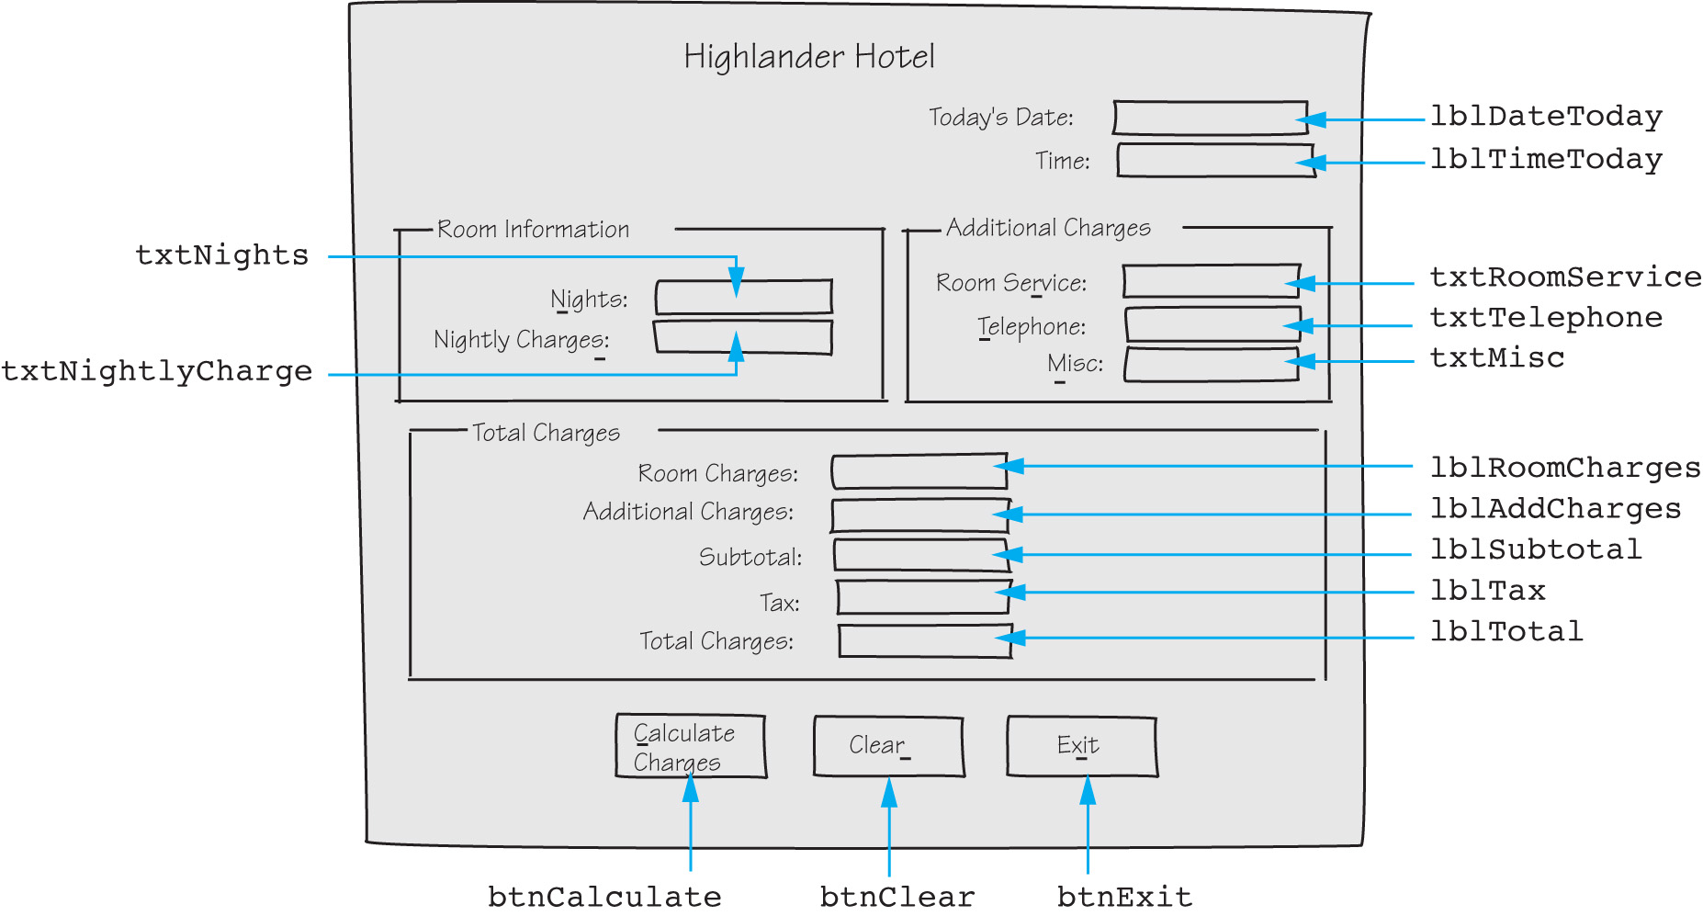
The Room Charge Calculator Application

Slide 94
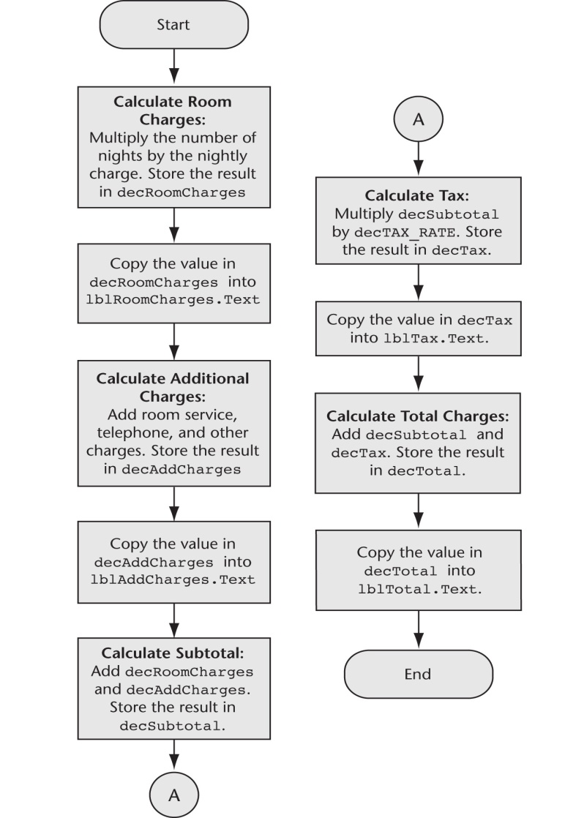
The btnCalculate Click Event

Slide 95
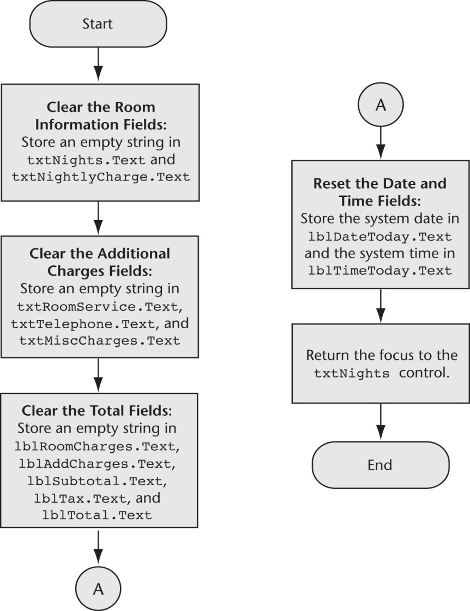
The btnClear Click Event

Slide 96
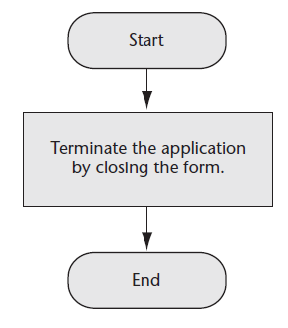
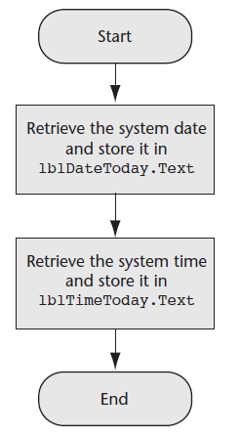
The btnExit Click Event & The Form1 Load Event

Slide 97
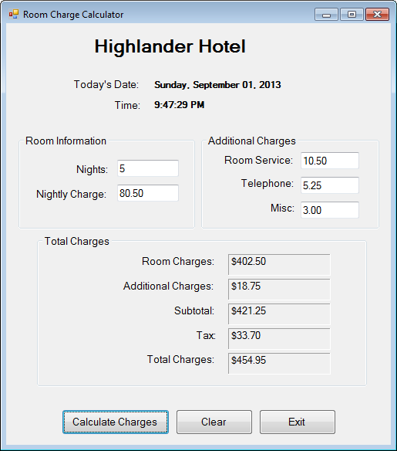
The Completed Form

Slide 98
Changing Colors with Code (Optional Topic)
You can change color properties with code
The following code sets the label’s background color to black and foreground color to yellow:
And the following code returns the background and foreground to the default colors
Tutorial 3-12 demonstrates how to change a label’s colors with code
lblMessage.BackColor = Color.Black
lblMessage.ForeColor = Color.Yellow
lblMessage.BackColor = SystemColors.Control
lblMessage.ForeColor = SystemColors.ControlText

Slide 99
More about Debugging: Locating Logic Errors
3.11

Slide 100
Debugging Problem
The program runs but does not work correctly (has one or more logic errors)
Running the program with various inputs has not isolated where those logic errors lie
What can be done?

Slide 101
Visual Basic Debugging Aids
You can set breakpoints
A line or lines you select in your source code
When execution reaches this line, it pauses
You may then examine the values in variables and certain control properties
You may also single-step through the program which executes one statement at a time
This allows you to see and examine:
What is happening one statement at a time
Where it is happening
What the various data values are (Watches)

Slide 102
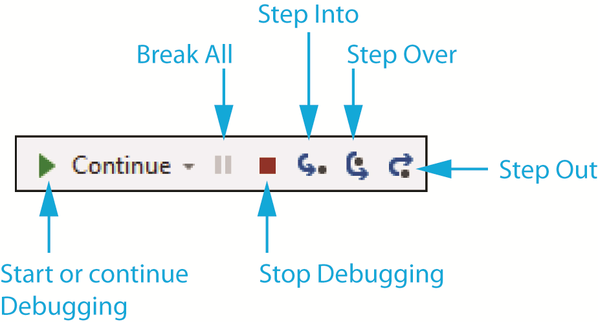
Debugging Commands in the Toolbar
Visual Studio provides a toolbar for debugging commands

Slide 103
Project
Go to socrative.com
Draw a sketch of your program
Create a flow chart using IO google
Create the program using Visual Basic
Create a power point presentation teaching the class how you completed your project
Objective
Students should be able to complete the development process for a computer application and present it to the class.

Slide 104
Vocab for Monday
Page 195
Access key
Argument
Binary operator
Breakpoint
Catch block
Catch clause

Slide 105
Vocab Chapter 3.2
Exception
Exception Handeler
Exception object
Focus
Focus method
function

Slide 106
Vocab Chapter 3.3
Logic error
Mathematical expression
Mnemonic
Named constant
Precedence
scope

Slide 107
Vocab Chapter 3.4
String concatenation
Tab order
ToString method
Try block
Try-catch statement
Variable
Variable declaration

Slide 108
Calculator
Create a GUI application that is a calculator
Notebooks are due today no excuses
Notebook requirement exercise Hotel, 3, 4, 5, 7, 8, 9, 10. Delgados and Calculator
Publishing Mid Term Grades Today!!
Objective
Student will be able to problem solve to create a GUI application for a calculator using ToString() conversion

